Slide 1
ASEN 2001 –Lab 1
Computer Analysis of Structures
Session 2

Slide 2
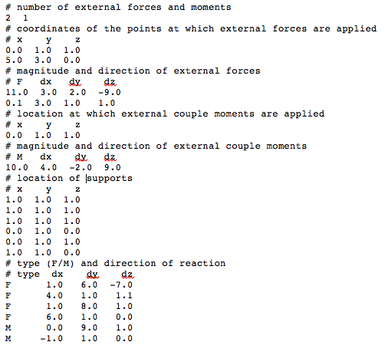
You should be at the point at which the input file can be read.
Now it’s time to formulate the equilibrium equations.
Input file

Slide 3
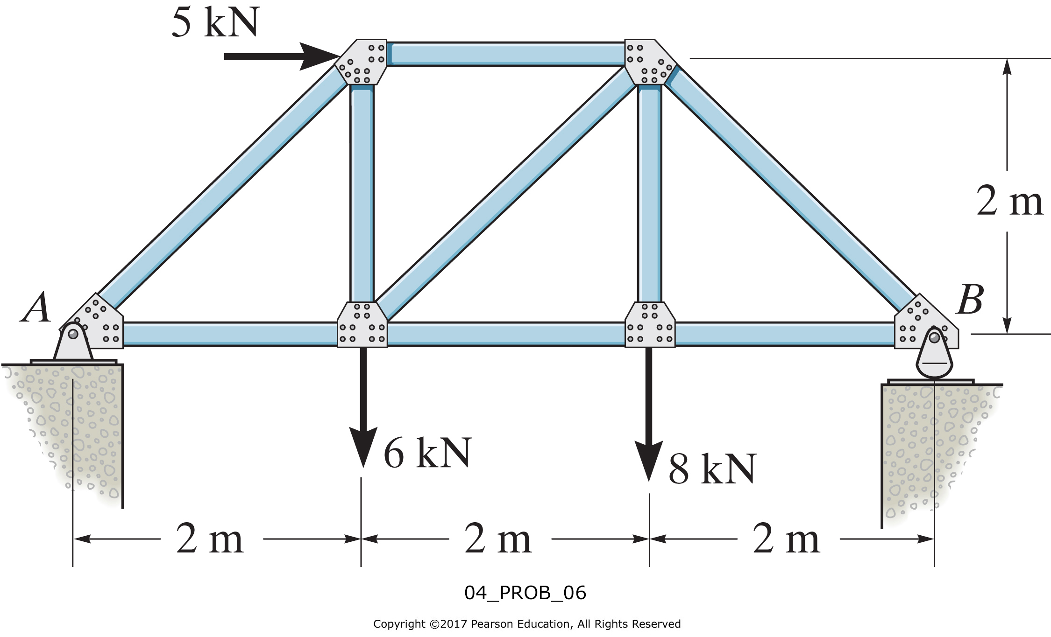
2-D example of formulating the equilibrium equations
10 kN

Slide 4
Free Body diagram
10 kN
y
R₁
x
R₂
R₃
Notes:
Notice point A is a pinned end condition, while point B is a rolling pinned end condition.

Slide 5
Reaction forces (and reaction moments)
10 kN
y
R₁
x
R₂
R₃
R₁ = R₁u_{R1}
R₂ = R₂u_{R2}
R₃ = R₃u_{R3}
R₁ = R₁ (u_{R1,x}i + u_{R1,y}j)
R₂ = R₂ (u_{R2,x}i + u_{R2,y}j)
R₃ = R₃ (u_{R1,x}i + u_{R1,y}j)
Notes:
u represents the unit vectors.

Slide 6
External forces and moments
M₁ = M₁ (k)
F₁ = F₁ (u_{F1,x}i + u_{F1,y}j)
10 kN
y
R₁
x
R₂
R₃
F₂ = F₂ (u_{F2,x}i + u_{F2,y}j)
F₃ = F₃ (u_{F3,x}i + u_{F3,y}j)

Slide 7
Position vectors
r_{M1} = (r_{M1,x}i + r_{M1,y}j)
r_{F1} = (r_{F1,x}i + r_{F1,y}j)
10 kN
y
r_{F2} = (r_{F2,x}i + r_{F2,y}j)
r_{F3} = (r_{F3,x}i + r_{F3,y}j)
R₁
x
R₂
R₃
r_{R1} = (r_{R1,x}i + r_{R1,y}j)
r_{R3} = (r_{R3,x}i + r_{R3,y}j)
r_{R2} = (r_{R2,x}i + r_{R2,y}j)
Notes:
Little r represents the position vectors. Diagonal line rF1 can be represented by its x and y coordinates in the i and j directions.

Slide 8
External moments about A
M₁ = M₁ (k)
10 kN
M_{F1} = r_{F1} x F₁
M_{F1} = M_{F1,z} (k)
y
R₁
x
R₂
R₃
M_{F2} = r_{F2} x F₂
M_{F3} = r_{F3} x F₃
M_{F2} = M_{F2,z} (k)
M_{F3} = M_{F3,z} (k)
Notes:
Notice here we still have not specified magnitude or direction(polarity) – yet! Still general. Moments on structure due to EXTERNAL sources!!

Slide 9
Moments of reactions about A
10 kN
M_{R1} = r_{R1} x R₁
M_{R1} = R₁ (r_{R1} x u_{R1})
M_{R1} = R₁ (r_{R1} x u_{R1})k
y
R₁
x
R₂
R₃
M_{R2} = r_{R2} x R₂
M_{R3} = r_{R3} x R₃
M_{R2} = R₂ (r_{R2} x u_{R2})
M_{R3} = R₃ (r_{R3} x u_{R3})
M_{R2} = R₂ (r_{R2} x u_{R2})k
M_{R3} = R₃ (r_{R3} x u_{R3})k
Notes:
Now add in the moment contributions from the reaction moments. Again, still general, even though we know moments from R1 and R2 are zero about pt A.

Slide 10
External Forces
Reaction Forces
F₁ = F₁ (u_{F1,x}i + u_{F1,y}j)
R₁ = R₁ (u_{R1,x}i + u_{R1,y}j)
F₂ = F₂ (u_{F2,x}i + u_{F2,y}j)
R₂ = R₂ (u_{R2,x}i + u_{R2,y}j)
F₃ = F₃ (u_{F3,x}i + u_{F3,y}j)
R₃ = R₃ (u_{R3,x}i + u_{R3,y}j)
External moments
Reaction moments
M_{F1} = M_{F1,z} (k)
M_{R1} = R₁ (r_{R1} x u_{R1})k
M_{F2} = M_{F2,z} (k)
Moments due to external forces
M_{R2} = R₂ (r_{R2} x u_{R2})k
Moments due to reaction forces
M_{F3} = M_{F3,z} (k)
M_{R3} = R₃ (r_{R3} x u_{R3})k
Moments due to external couple moments
No reaction couple moments in this example
M₁ = M₁ (k)
Equilibrium Equations
R₁ u_{R1,x}
+ R₂ u_{R2,x}
+ R₃ u_{R3,x}
+ F₁ u_{F1,x}
+ F₂ u_{F2,x}
+ F₃ u_{F3,x} = 0
Notes:
Bad setup – reactions are on the left now and externals are on the right. Should be switched.

Slide 11
External Forces
Reaction Forces
F₁ = F₁ (u_{F1,x}i + u_{F1,y}j)
R₁ = R₁ (u_{R1,x}i + u_{R1,y}j)
F₂ = F₂ (u_{F2,x}i + u_{F2,y}j)
R₂ = R₂ (u_{R2,x}i + u_{R2,y}j)
F₃ = F₃ (u_{F3,x}i + u_{F3,y}j)
R₃ = R₃ (u_{R3,x}i + u_{R3,y}j)
External moments
Reaction moments
M_{F1} = M_{F1,z} (k)
M_{R1} = R₁ (r_{R1} x u_{R1})k
M_{F2} = M_{F2,z} (k)
Moments due to external forces
M_{R2} = R₂ (r_{R2} x u_{R2})k
Moments due to reaction forces
M_{F3} = M_{F3,z} (k)
M_{R3} = R₃ (r_{R3} x u_{R3})k
Moments due to external couple moments
No reaction couple moments in this example
M₁ = M₁ (k)
Equilibrium Equations
R₁ u_{R1,x}
+ R₂ u_{R2,x}
+ R₃ u_{R3,x}
+ F₁ u_{F1,x}
+ F₂ u_{F2,x}
+ F₃ u_{F3,x} = 0
R₁ u_{R1,y}
+ R₂ u_{R2,y}
+ R₃ u_{R3,y}
+ F₁ u_{F1,y}
+ F₂ u_{F2,y}
+ F₃ u_{F3,y} = 0

Slide 12
External Forces
Reaction Forces
F₁ = F₁ (u_{F1,x}i + u_{F1,y}j)
R₁ = R₁ (u_{R1,x}i + u_{R1,y}j)
F₂ = F₂ (u_{F2,x}i + u_{F2,y}j)
R₂ = R₂ (u_{R2,x}i + u_{R2,y}j)
F₃ = F₃ (u_{F3,x}i + u_{F3,y}j)
R₃ = R₃ (u_{R3,x}i + u_{R3,y}j)
External moments
Reaction moments
M_{F1} = M_{F1,z} (k)
M_{R1} = R₁ (r_{R1} x u_{R1})k
M_{F2} = M_{F2,z} (k)
Moments due to external forces
M_{R2} = R₂ (r_{R2} x u_{R2})k
Moments due to reaction forces
M_{F3} = M_{F3,z} (k)
M_{R3} = R₃ (r_{R3} x u_{R3})k
Moments due to external couple moments
No reaction couple moments in this example
M₁ = M₁ (k)
Equilibrium Equations
R₁ u_{R1,x}
+ R₂ u_{R2,x}
+ R₃ u_{R3,x}
+ F₁ u_{F1,x}
+ F₂ u_{F2,x}
+ F₃ u_{F3,x} = 0
R₁ u_{R1,y}
+ R₂ u_{R2,y}
+ R₃ u_{R3,y}
+ F₁ u_{F1,y}
+ F₂ u_{F2,y}
+ F₃ u_{F3,y} = 0
R₁ (r_{R1} x u_{R1})
+ R₂ (r_{R2} x u_{R2})
+ R₃ (r_{R3} x u_{R3})
+ M_{F1,z}
+ M_{F2,z}
+ M_{F3,z}
+ M₁ = 0

Slide 13
Equilibrium Equations
R₁ u_{R1,x}
+ R₂ u_{R2,x}
+ R₃ u_{R3,x}
+ F₁ u_{F1,x}
+ F₂ u_{F2,x}
+ F₃ u_{F3,x} = 0
R₁ u_{R1,y}
+ R₂ u_{R2,y}
+ R₃ u_{R3,y}
+ F₁ u_{F1,y}
+ F₂ u_{F2,y}
+ F₃ u_{F3,y} = 0
R₁ (r_{R1} x u_{R1})
+ R₂ (r_{R2} x u_{R2})
+ R₃ (r_{R3} x u_{R3})
+ M_{F1,z}
+ M_{F2,z}
+ M_{F3,z}
+ M₁ = 0
Known values
R₁ u_{R1,x}
+ R₂ u_{R2,x}
+ R₃ u_{R3,x}
= - (F₁ u_{F1,x}
+ F₂ u_{F2,x}
+ F₃ u_{F3,x})
R₁ u_{R1,y}
+ R₂ u_{R2,y}
+ R₃ u_{R3,y}
= - (F₁ u_{F1,y}
+ F₂ u_{F2,y}
+ F₃ u_{F3,y})
R₁ (r_{R1} x u_{R1})
+ R₂ (r_{R2} x u_{R2})
+ R₃ (r_{R3} x u_{R3})
= - (M_{F1,z}
+ M_{F2,z}
+ M_{F3,z})
In matrix form
Notes:
Known values from external forces and moments. Solve for reactions R1 - R3

Slide 14
10 kN
y
R₁
x
R₂
R₃
Equilibrium equations for this example in matrix form
Notes:
Top row Fx sum, second row Fy sum, last row Mz sum. All external forces cause negative moments: (5x2+10+6x2+8x4) = 64

Slide 15
